Slide 1
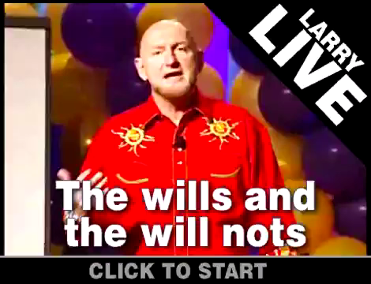
Larry Wingit – The wills and the will nots

